Slide 1
Coverage Benefits and Discounts
Eileen M. Knapp, LUTCF, Senior Sales Representative
Notes:
Introduce yourself.
***Be sure to update the cover slide to include your full name and date***
Let your audience know what you will be reviewing over the next 20 minutes.

Slide 2


Discounts Available Through Liberty Mutual
Exclusive Group Savings
Multi-Policy Discount
Multi-Car Discount
Preferred Payments Method Discounts
Vehicle Safety Features Discount
Hybrid Vehicle Discount
Good Student Discount
RightTrack¹
And more…
Applies to: AL, AZ, AR, CO, CT, DE, DC, FL, GA, ID, IL, Indiana, IA, KS, KY, LA, ME, MD, MA, MI, MN, MS, MO, NE, NV, NH, NJ, NM, NY, OH, OK, Oregon, PA, RI, SC, TN, TX, UT, VT, VA, WV, WI

Slide 3

RightTrack & By-Mile
Be Rewarded For Your Good Driving Habits!
RightTrack
A vehicle level program. Customer saves between 10% and 30% on the annual premium after a 90 day evaluation period.
RightTrack: Applies to: AL, AZ, AR, CO, CT, DE, DC, FL, GA, ID, IL, Indiana, IA, KS, KY, LA, ME, MD, MA, MI, MN, MS, MO, NE, NV, NH, NJ, NM, NY, OH, OK, Oregon, PA, RI, SC, TN, TX, UT, VT, VA, WV, WI

Slide 4

Coverage Benefits With Liberty Mutual
Local Licensed Sales Agents
Accident Forgiveness¹
New Car Replacement²
Lifetime Repair Guarantee³
Better Car Replacement™
12 month rate lock
24/7 Claims Assistance
Original Parts Replacement⁴
Deductible Fund™⁵
Accident Forgiveness is subject to terms and conditions of Liberty Mutual's underwriting guidelines. Not available in CA and may vary by state.
Applies to a covered total loss. Your car must be less than one year old, have fewer than 15,000 miles and have had no previous owner. Does not apply to leased vehicles or motorcycles. Subject to applicable deductible. Not available in NC or WY.
Loss must be covered by your policy. Not available in AK.
Applies to AR, DC, DE, IA, ID, IL, KS, KY, MO, MD, MS, ND, NE, NM, OH, OR, PA, TN, VA, WI auto policies
Applies to AL, AZ, AR, CO, CT, DE, DC, GA, HI, ID, IL, Indiana, IA, KS, KY, LA, ME, MD, MA, MI, MN, MS, MO, MT, NE, NV, NH, NJ, NM, NY, ND, OH, OK, Oregon, PA, RI, SC, TN, TX, UT, VT, VA, WA, WV, WI, WY
Notes:
Local Licensed Sales and Service Reps
TIP: This is your opportunity to advocate for your services. This is a major differentiator from your competition, so take this time to express your value as their agent.
Accident Forgiveness
With Accident Forgiveness, we won't raise your price due to your first accident if your driving record is accident-free and violation-free for five years, whether you've been with Liberty Mutual or a prior insurance carrier. If you qualify, you'll receive this benefit at no extra cost.
New Car Replacement
New Car Replacement is a standard feature on Liberty Mutual auto policies. If your car is totaled in the first year, you'll get the money for a brand new car, not just the depreciated value. Your policy deductible applies, and coverage is for autos less than one year old, not previously owned, with less than 15,000 miles. Leased autos and motorcycles are excluded. New car replacement coverage is not available in North Carolina and Wyoming.
Lifetime Repair Guarantee
Receive a Lifetime Repair Guarantee when you fix your car at one of our approved repair shops. We'll even make the arrangements.
Original Parts Replacement/OEM: Original Parts Replacement is optional coverage that allows customers to buy OEM new parts. Available for private passenger autos 10-years-old and newer. Comprehensive and Collision coverage required. This endorsement guarantees they'll receive OEM new parts as long as they're produced and distributed. Glass included.
Deductible Fund: The last thing you want to think about after an accident is your deductible. We'll lower your collision deductible on every car on your policy by $100 each year you keep the fund. This endorsement reduces or eliminates out-of-pocket collision deductibles for claims.
Eligibility and benefits:
Collision coverage required to purchase
Fund earns $100 each year
No expiration of funds with endorsement
No maximum limit on earnings
Priced at $30 per policy, with the exception of CT and RI.
For NY policies, deductibles aren't reduced below $100.

Slide 5

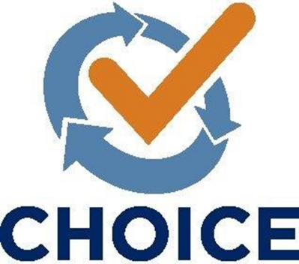



CHOICE
Liberty Mutual believes in customized insurance so you only pay for what you need. That’s why if we can’t help you, we’ll find someone who can.
We Consult with You
We take the time to understand your unique needs and determine your best coverage options.
We Shop for You
If our products aren’t the best fit for your needs, we’ll shop for you to make sure you get the right coverage at the right value, saving you the time and stress of shopping multiple carriers.
You Choose Your Coverage
We present you with a list of recommended options from over 20 A-rated carrier partners, ensuring you get coverage that fits you best.
We Complete the Process
We finalize the sale on your behalf and provide all the necessary information,
so you feel confident about your new coverage.
Helping You Find The Perfect Coverage
If coverage is sought from one of Liberty Mutual’s carrier partners, coverage is provided and underwritten by that carrier partner and/or its affiliates. For further information, you may contact your Liberty Mutual representative. Coverage provided and underwritten by Liberty Mutual Insurance and its affiliates, 175 Berkeley Street, Boston, MA 02116 USA. ©2019 Liberty Mutual Insurance 12234903

Slide 6
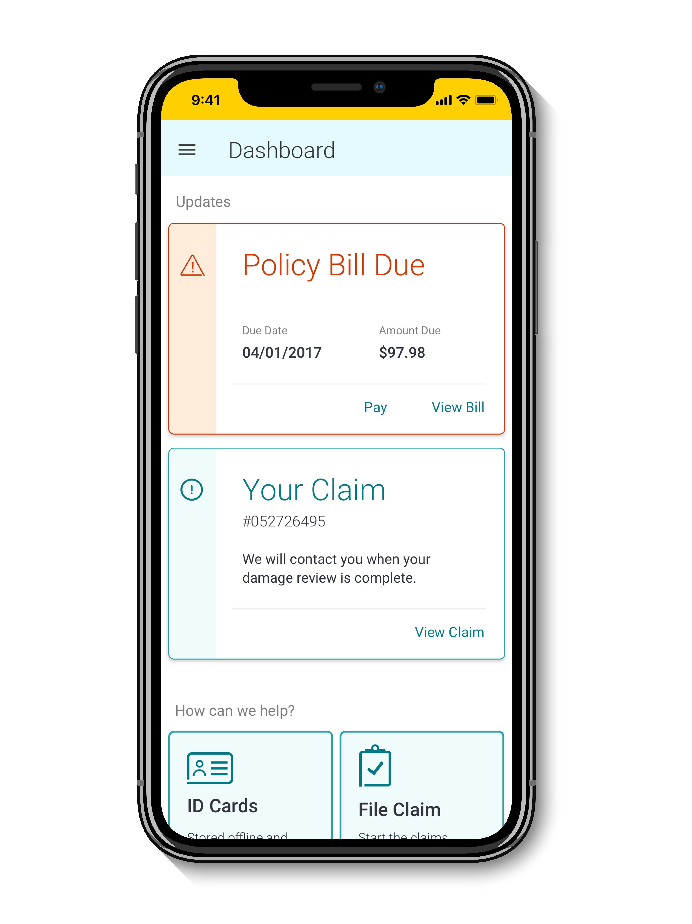


Liberty Mutual Free Core Services App (LM Mobile)
Manage your policy
Take your account anywhere so you can easily:
Access policy documents and ID cards
Pay your bill
Update your policy, billing, and contact information
File and manage claims
If you're in an accident or need to file a claim, you can use the Liberty Mutual app to:
File a claim within five minutes
Manage your existing claim
Request Roadside Assistance¹
Upload photos to get an Express Estimate™ for your auto repair

Slide 7
Questions?
If you have any questions or would like a free, no obligation coverage review or rate quote, please don’t hesitate to contact:
Eileen M. Knapp, LUTCF
Senior Sales Representative
Eileen.knapp@libertymutual.com
631-639-3792 DIRECT#

